Slide 1
OnStar FMV
Katrina Anderson
Chris Celotto
Jessica Jacovino
Brian Rogers
Evan Telios

Slide 2
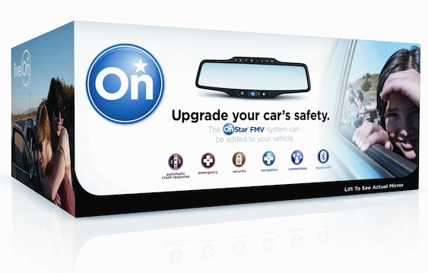
Overview & Business Strategy

Slide 3
OnStar FMV (For My Vehicle)
OnStar has been a subsidiary of GM since 1995. It connects drivers with a series of safety features on the road.
Features vary from Roadside Assistance, to Automatic Crash Response to basic navigation.
Summer of 2011, OnStar released the FMV which is a rear-view mirror that brings all the feature of the OnStar service to non-GM car owners.

Slide 4
Vision
“OnStar strives to be the leading company in providing wireless connection to vehicles and simple technological services “that deliver unmatched peace of mind and significantly improve the safety and well-being of subscribers”

Slide 5
Mission
“To define the future of vehicular connectivity by providing high-level services that deliver safety, security and peace of mind to consumers on the road”

Slide 6
Sustainability
GM along with OnStar is in the middle of launching first-ever pilot program of “smart-grid” solutions for electric vehicles
“offer a short-cut to connect electronic vehicles to the smart grid”
Management hub
Smart Grid technology will allow GM and OnStar to maximize vehicle charging efficiency and minimize customer costs
ATOMS technology
http://green.tmcnet.com/topics/green/articles/199029-general-motors-onstar-launch-smart-grid-solutions-electric.htm and http://www.greenbiz.com/news/2011/07/20/general-motors-upgrades-onstar-power-first-real-world-smart-grid-ev-pilot
and http://www.mobilemarketer.com/cms/news/software-technology/5036.html

Slide 7
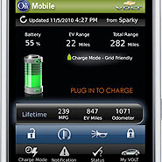
Sustainability
Mobile App that allows Chevy Volt owners to control OnStar features

Slide 8
Marketing Strategy

Slide 9
Product
Actual rear view mirror
Services
Automatic Crash Response
Stolen Vehicle Assistance
Navigation
Hands-free Calling
FMV is “brand extension” of OnStar
Satisfies business strategy by connecting drivers through telematics technology to emergency, “piece of mind” and security related services

Slide 10
Price
$299
Set up fees
Monthly Plans
Safe & Sound at $18.95/ month
Directions & Connections at $28.90/ month
In paying this customers are attaining high level services that could potentially save their lives

Slide 11
Promotion
Scare tactic
FMV
Navigation

Slide 12
Place
Selective Distribution
Best Buy
Crutchfield
Handful of smaller online distributors
Online availability is the epitome of connectivity which is a huge aspect of OnStar’s mission.

Slide 13
Operations Strategy
Treacy & Wiersema’s

Slide 14
Operational Excellence
Provide services quick and easily with just the press of a button
They have a reputation of having the best and most reliable services and customer service
Quickest service in emergency situations
OnStar’s staff can answer 99.7% of emergency calls within 1 second

Slide 15
Customer Intimacy
Customers can talk to a real person at anytime to give them assistance
OnStar provides onstarconnections.com for customers
Submit comments, complaints, etc.
Talk in forums with other customers
Get help from OnStar representatives

Slide 16
Product Leadership
First to use this technology and a leader in the industry
FMV is an example of OnStar’s constant innovation and improvements to maintain their position as leaders in the industry
Stolen-vehicle assistance service
Only service of its type and only offered by OnStar

Slide 17
Integration/Value Creation
Smart Grid is an extension of the connectivity stressed in both the marketing and OM strategies
Drivers connect with a variety of safety, security and emergency service personnel
Now they will be able to connect with their vehicle and its environmental impact

Slide 18
Triple Bottom Line

Slide 19
People
Vision statement mentions how OnStar and the FMV provide drivers with “piece of mind”
Services can and have saved many lives
Value
OnStar put a lot of effort into ensuring that their customer service and emergency advisor employees are well trained and educated
National Academic of Emergency Dispatch
2005 OnStar was awarded the Good Housekeeping Seal for “Best Service Award”
“The Seal has been reassuring consumers about their product-purchasing decisions for over 100 years and is one of the most recognized consumer emblems in the market today.”
Profits
http://www.prnewswire.com/news-releases/onstar-fmv-mirror-earns-good-housekeeping-seal-128822858.html

Slide 20
Planet
Getting involved with the Smart Grid has been OnStar’s biggest involvement with environmental sustainability.
Potential to extend customer connectivity to environmental services as well

Slide 21
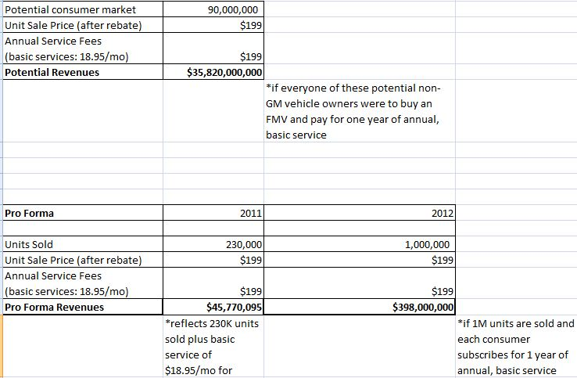
Profits
Profit
www.Ceooutlook.com and www.engadget.com

Slide 22
Adding to the Triple Bottom Line
FMV could be more environmentally friendly by using less plastic materials or using recycled materials in the manufacturing of the mirror itself.
OnStar could encourage drivers to be more environmentally friendly on the road
Key into style of driving
Promote eco-friendly/ hybrid cars
OnStar starting to work with the Smart Grid is a potential sign for the FMV to offer services like this in the future

Slide 23
Thank You
Question & Answer

